Slide 1



SkillCourt 7.0
Team Members: Alvaro Silva,Antonio Riverol,Chandan Aubel Product Owner: Guðmundur Traustason
Instructor: Masoud Sadjadi School of Computing and Information Sciences Florida International University
Final Presentation
Spring 2017
Notes:
7 seconds.( I will select 2 best slides (i will give them extra points and students will present for CIS committee)
Greet your audience, thank them for attending your presentation, introduce yourself, introduce your project, introduce your team members, and quickly indicate what each of you did in a high-level manner, and put more emphasis on your part/contribution.

Slide 2
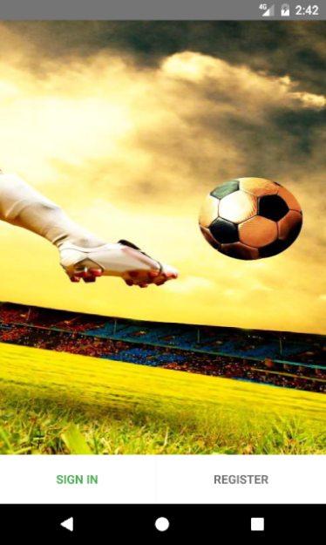
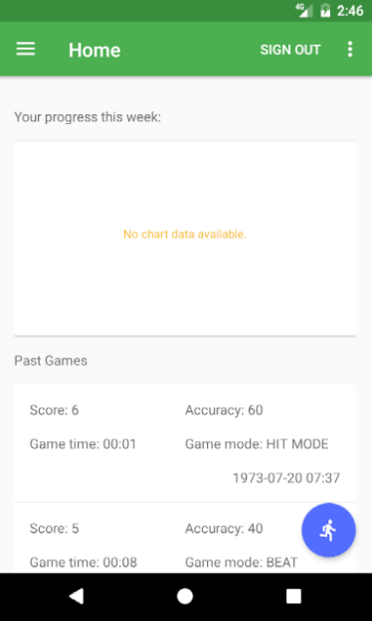
Project definition
SkillCourt is an interactive training system designed for improving the performance of athletes.
SkillCourt App is running in Android and is connected to pads via bluetooth using Arduinos.
Notes:
10 seconds.
Introduce the problem that the whole project (in all versions) tackles with GIF or screenshot.

Slide 3
Project definition
This Semester, the SkillCourt Application implemented its first version of a multiplayer game. Players will now be able to match up against each other head-to-head in a competitive environment.
SkillCourt lacks a website, and therefore lacks a quick and easy way to inform interested parties about the SkillCourt system. A website should be built (from scratch) to be informative and to allow individuals to create their own accounts for future use.
Notes:
20 seconds.
Introduce the problem that the your project (in new version) tackles with GIF or screenshot.

Slide 4
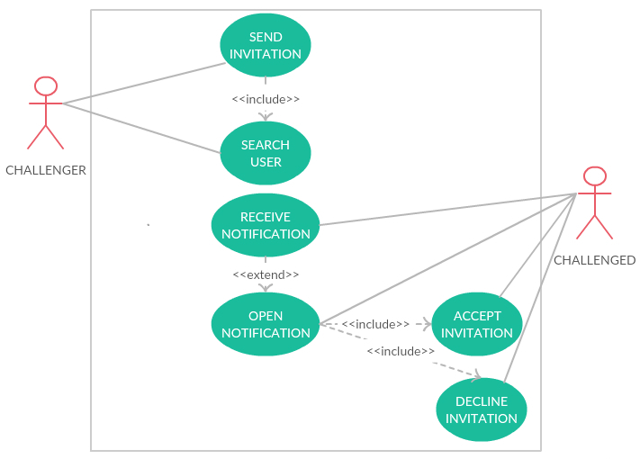
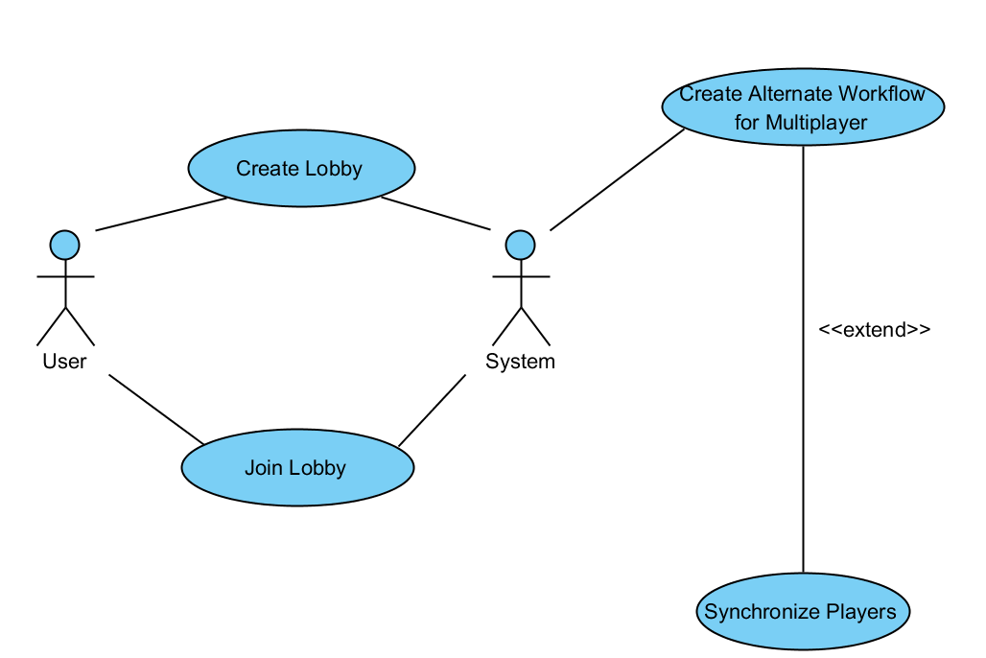
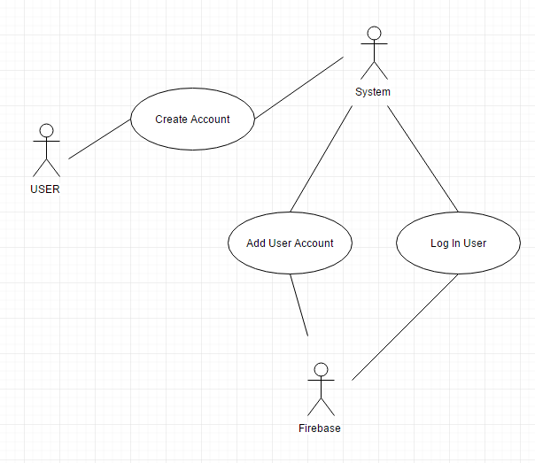
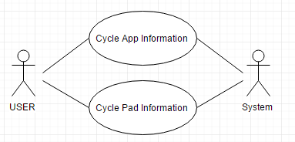
Requirements: Use Cases
Notes:
5 seconds
Show the Use Case Diagram for the whole project. Highlight your use cases.

Slide 5
System Design: Architecture
SkillCourt Application:
Developed in Android Studio for mobile devices
Connects to Arduino boards in nearby pads
Sends notifications through a Node.js server
Communicate with the server using HTTP requests
SkillCourt.com:
MVC framework used to separate views from the logic of the site
Requirements for deployment:
Any system paired with an up-to-date web browser
Notes:
20 seconds
System design: Highlight the parts that you contributed to them.
1. System decomposition; identify the architecture patterns used
2. System deployment – h/w and s/w requirements

Slide 6
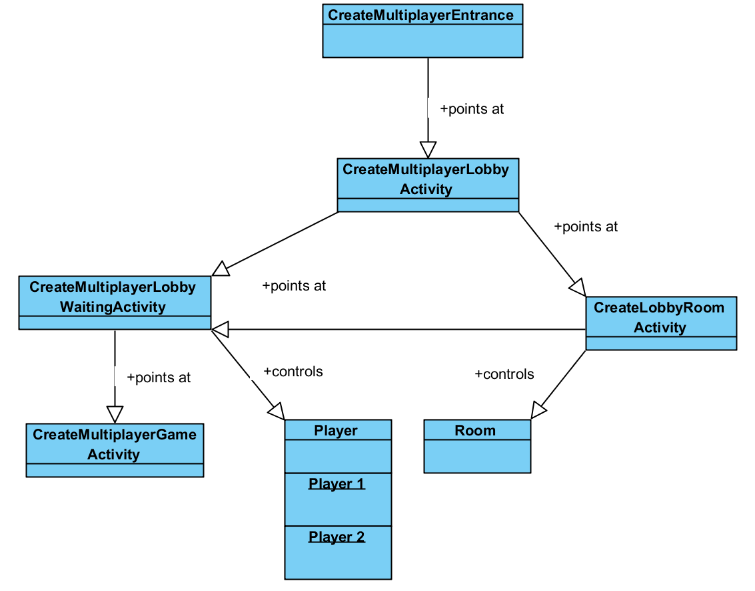
Minimal Class Diagram
Notes:
10 seconds.Minimal class diagram. Highlight the classes that you created/modified
Identify the design patterns used (one or more slides).

Slide 7
User Stories
1. Send Invitation
2. Search User
3. Create Lobby
4. Join Lobby
5. Mobile Formatting and Standard Login for Website
Notes:
5 seconds.
List the user stories that you worked on them.(put in order of importance). Stay focused on the parts that you have been working.

Slide 8
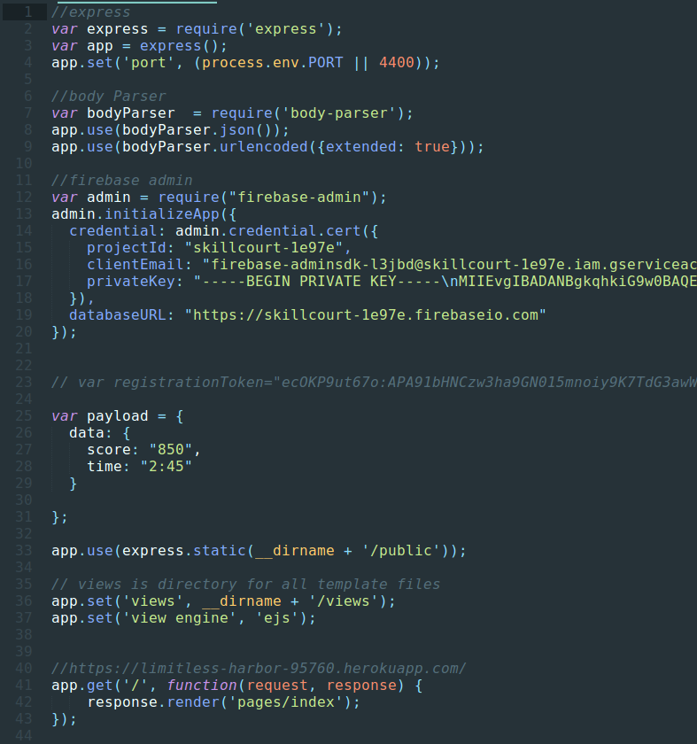
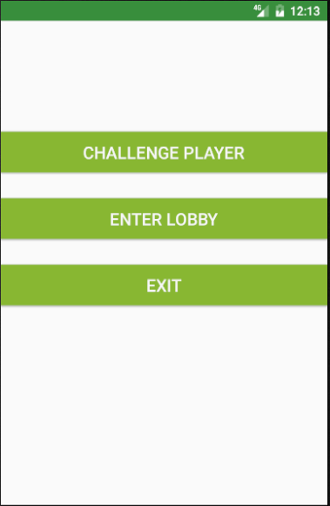
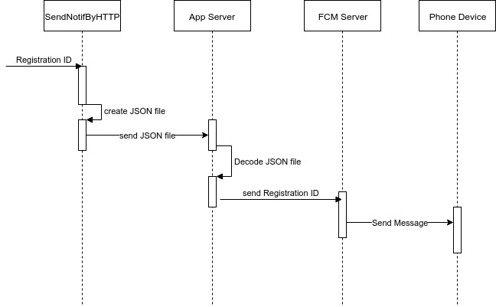
User Story #1: Send Invitation
Description:
Allow the user to send multiplayer invitations to other users.
Send the invitation via a Node.Js Server and the FCM Server
Notes:
60 seconds
The tile of user story
The most important user story you worked on it. You have to describe this one very well and be proud of that.
Please present and show the complexity of your work, code, algorithms, and technical challenges and technologies you have used. (you could use screenshot if you want. Visual presentations are better than text presentation)
Go into the details of the most important/significant tasks using bullet lists or visual graphs or state chart diagram
Sequence Diagram for this user story is mandatory (in another separate page if required)
Demo using screenshots or GIF (in another separate page if required)

Slide 9
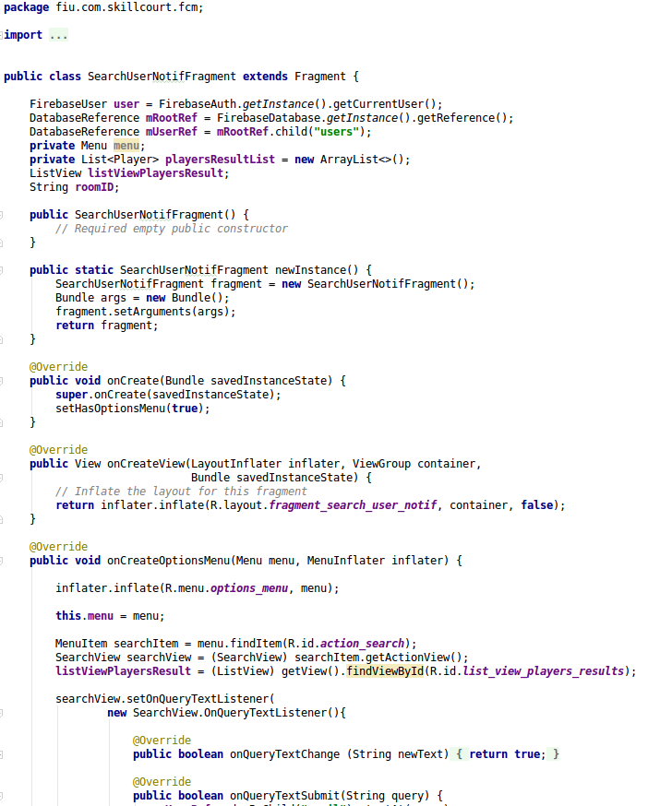
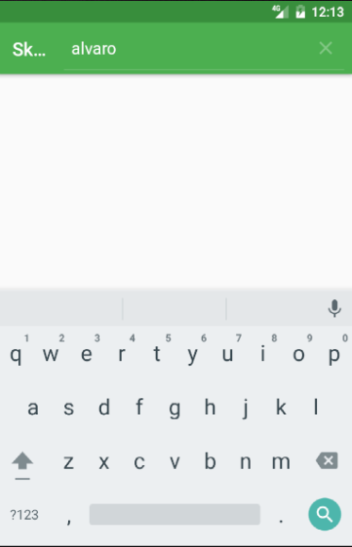
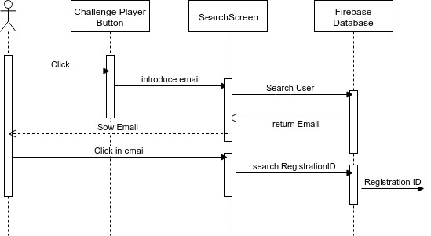
User Story #2: Search User
Description:
Allow the user to search others and select the one to send the invitation
It extends the Send Invitation Use Case
Notes:
20 seconds
The tile of user story
Please present and show the complexity of your work, code, algorithms, and technical challenges and technologies you have used. (you could use screenshot if you want. Visual presentations are better than text presentation) - Go into the details of the most important/significant tasks using bullet lists or visual graphs or state chart diagram - Demo using screenshots or GIF (in another separate page if required)
Sequence Diagram for this user story is optional

Slide 10
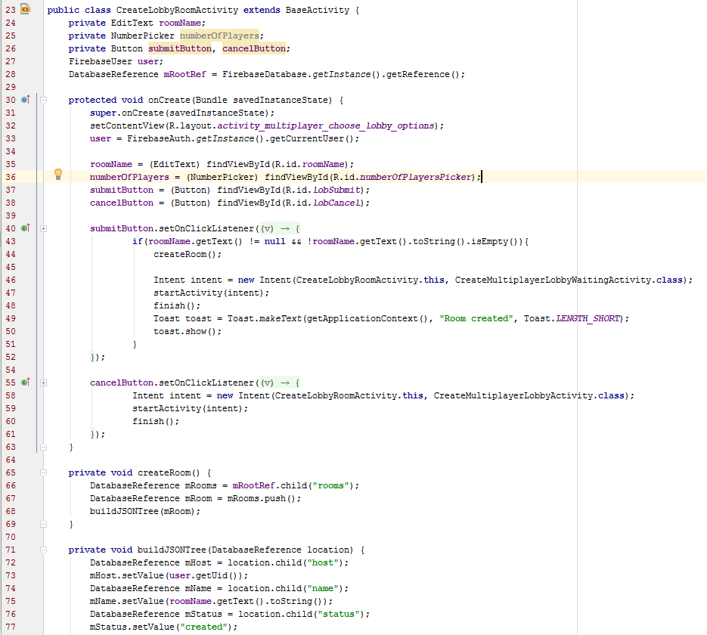
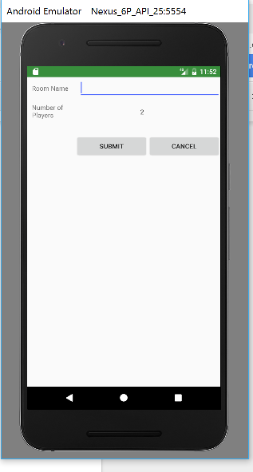
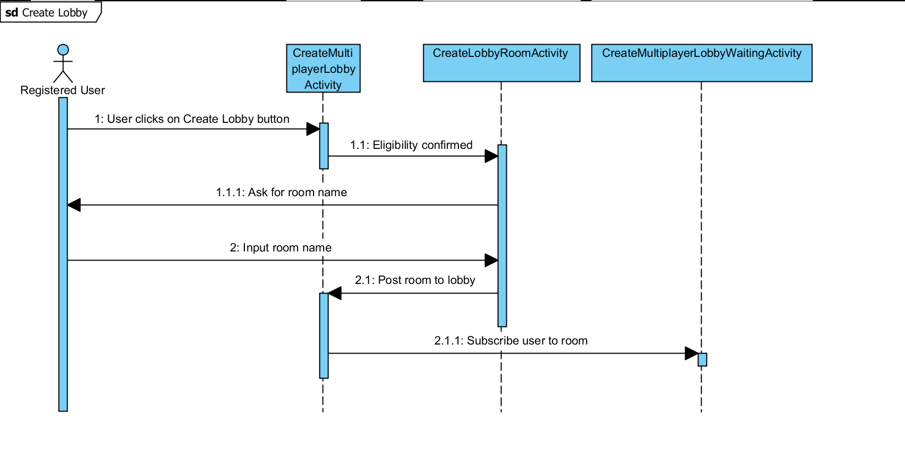
User Story #3: Create Lobby
Description:
Allow the user to create their own room in Firebase to join with another player
Set their own rules and number of pads for this specific room
c
Notes:
20 seconds
The tile of user story
Please present and show the complexity of your work, code, algorithms, and technical challenges and technologies you have used. (you could use screenshot if you want. Visual presentations are better than text presentation) - Go into the details of the most important/significant tasks using bullet lists or visual graphs or state chart diagram - Demo using screenshots or GIF (in another separate page if required)
Sequence Diagram for this user story is optional

Slide 11
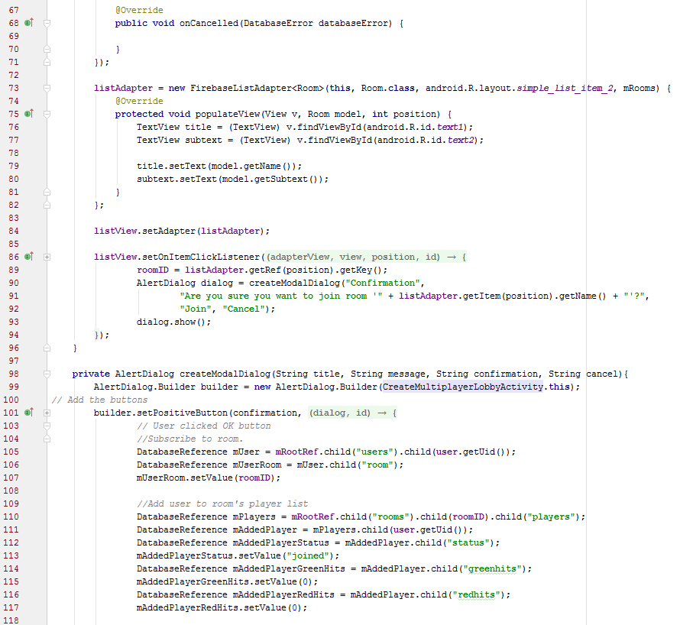
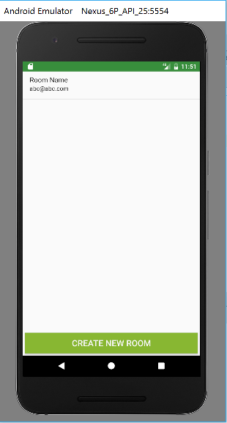
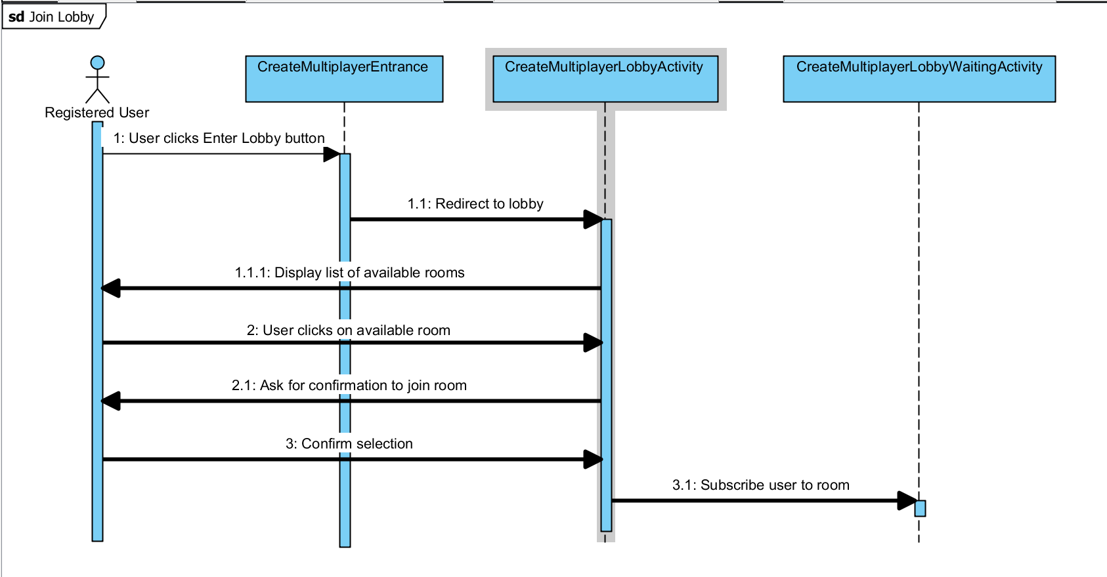
User Story #4: Join Lobby
Description:
Allow the user to join an existing room in Firebase to join with another player
Load host’s room data and profile into UI
Notes:
20 seconds
The tile of user story
Please present and show the complexity of your work, code, algorithms, and technical challenges and technologies you have used. (you could use screenshot if you want. Visual presentations are better than text presentation) - Go into the details of the most important/significant tasks using bullet lists or visual graphs or state chart diagram - Demo using screenshots or GIF (in another separate page if required)
Sequence Diagram for this user story is optional

Slide 12
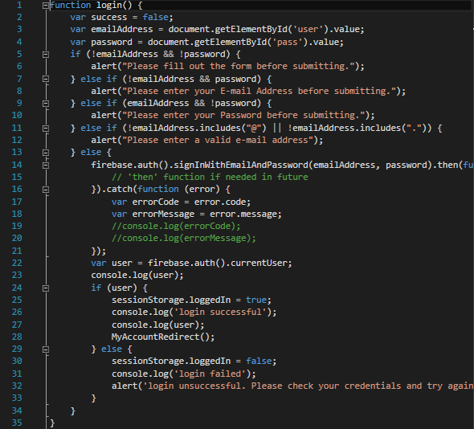
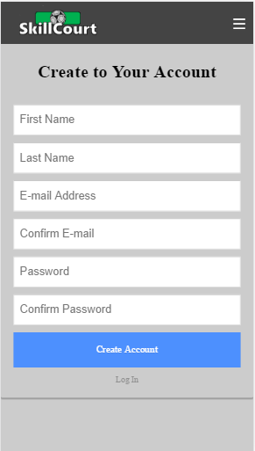
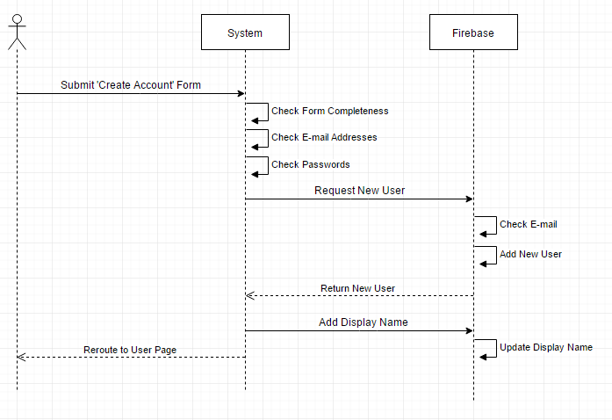
User Story #5: Mobile Formatting and Standard Login
Description:
Allow the SkillCourt website to scale depending on the device accessing the site
Allow Users to create a new account with SkillCourt using an e-mail/password combination, and then log-in to SKillCourt with their new account.
Notes:
20 seconds
The tile of user story
Please present and show the complexity of your work, code, algorithms, and technical challenges and technologies you have used. (you could use screenshot if you want. Visual presentations are better than text presentation) - Go into the details of the most important/significant tasks using bullet lists or visual graphs or state chart diagram - Demo using screenshots or GIF (in another separate page if required)
Sequence Diagram for this user story is optional

Slide 13
Test Suites and Test Cases
Use Case: Send Invitation
Description/Summary of Test: Test if the implementation for sending the notification for multiplayer mode works..
Pre-condition: SkillCourt app running and app server is deployed.
Expected Results: Convert the Registration ID in a JSON object, send this to the app server, server to decode, send the Registration ID to FCM Server; create a room and add the challenger to it.
Actual Result: Converts, decodes, send the Registration ID, creates the room and adds the challenger.
Status (Fail/Pass): Pass.
Notes:
10 seconds
A description of verification process and Test Suites and Test Cases for one of the use cases.
1 One sunny day and one rainy day for the implemented use cases (one or more slides).
2 Automated test scripts for the implemented use cases (if any) (one or more slides).

Slide 14




Summary
For the duration of the semester, Chandan and Alvaro worked on the mobile application while Antonio built the website. We met each week in the MARC building and kept in contact each day for updates on our progress with Mingle and Whatsapp.
Chandan Aubel - caube001@fiu.edu
Alvaro Silva - asilv129@fiu.edu
Antonio Riverol - riverol26@aol.com
Notes:
10 seconds
Summarize your contribution, mention your effort for Scrum, Mingle, Github, Google Drive Documentation and minutes
Include your contact information
Ask if anyone has any questions for you.
Thank your audience

